Slide 1
VEHICLE RENTAL SYSTEM Iips davv college (Integrated m.tech)
ANSHIMA SHARMA

Slide 2
INTRODUCTION a WEB BASED SYSTEM FOR USERS TO RENT VEHICLES AND CAN SEE THEIR BOOKINGS.
USER SPECIFIC
Login
Book rentals
View bookings
ADMIN SPECIFIC
Add vehicles
Add and view users
View customer bookings

Slide 3
Frontend: HTML, CSS, JavaScript
Backend: Spring Boot
Database: PostgreSQL

Slide 4
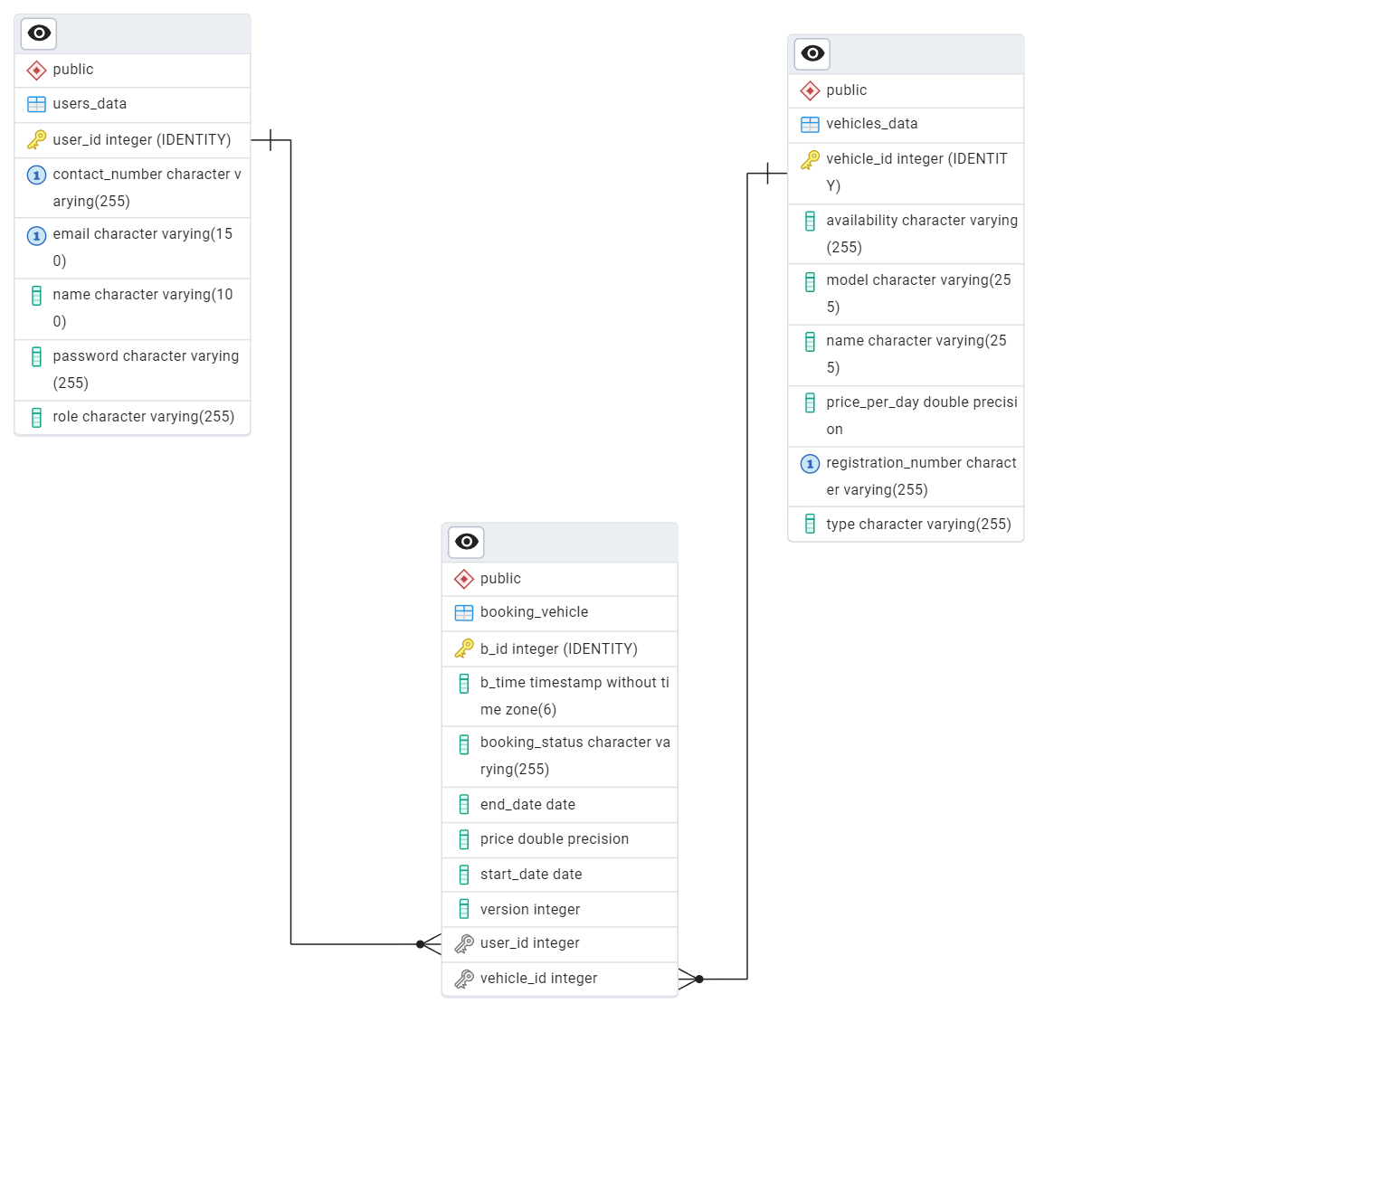
ER DIAGRAM

Slide 5
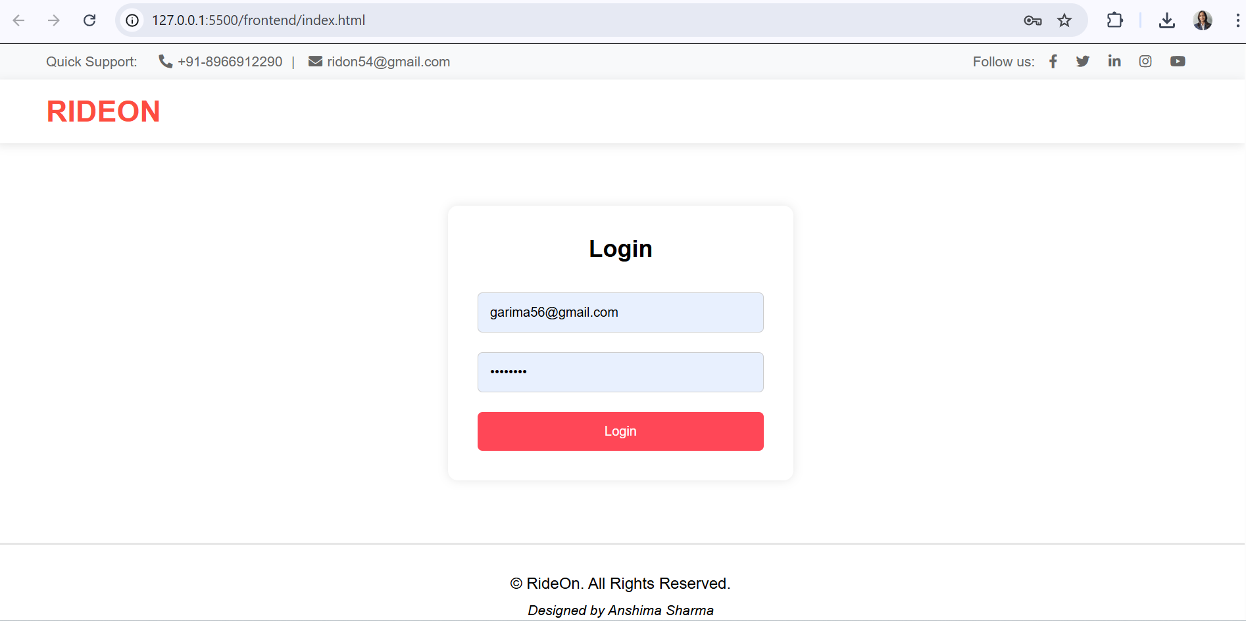
FEATURES- 1. login page

Slide 6
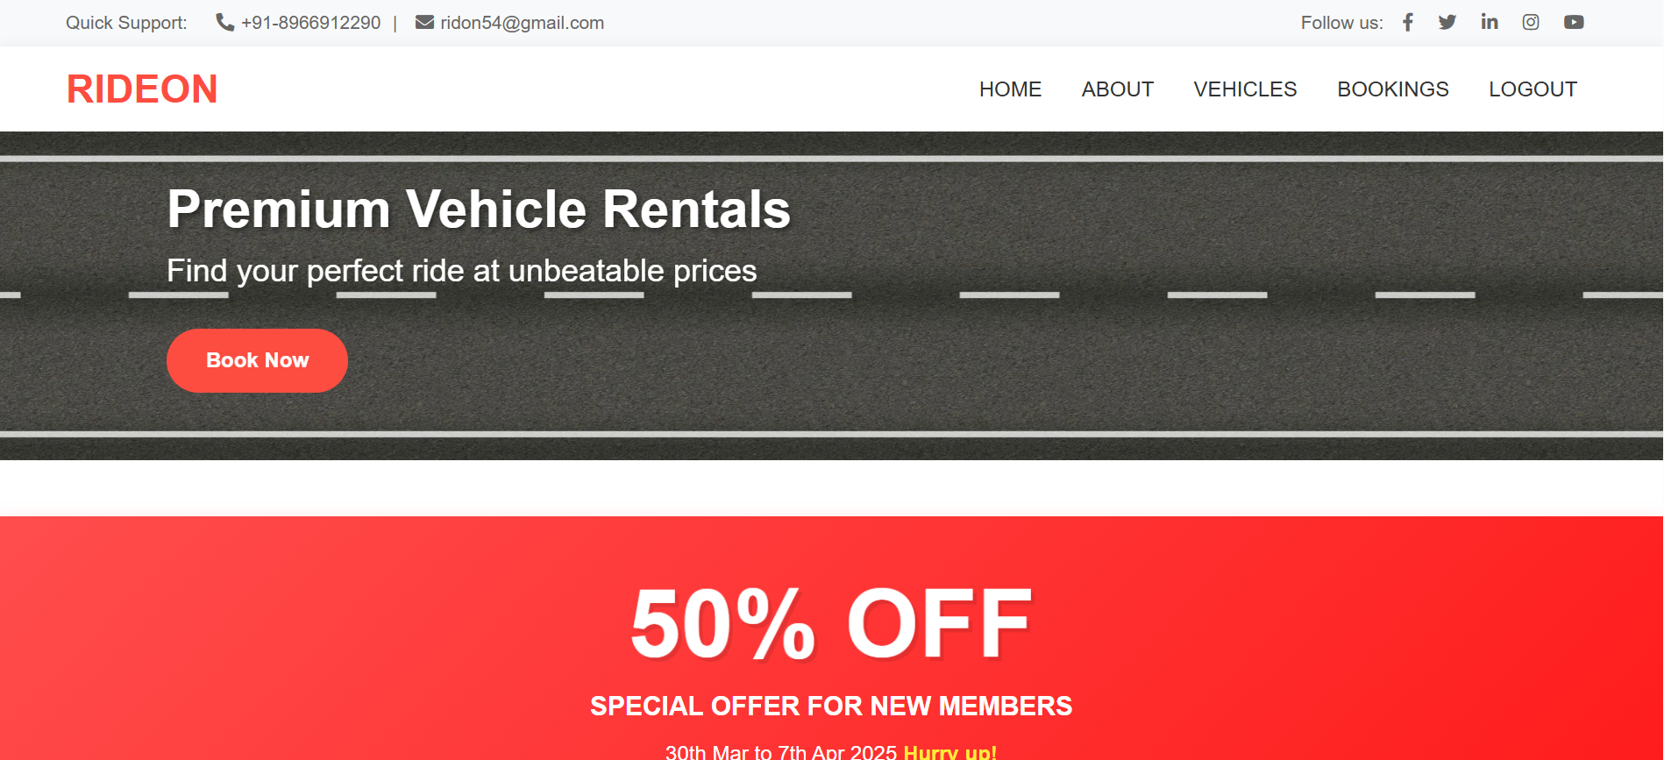
User home page

Slide 7
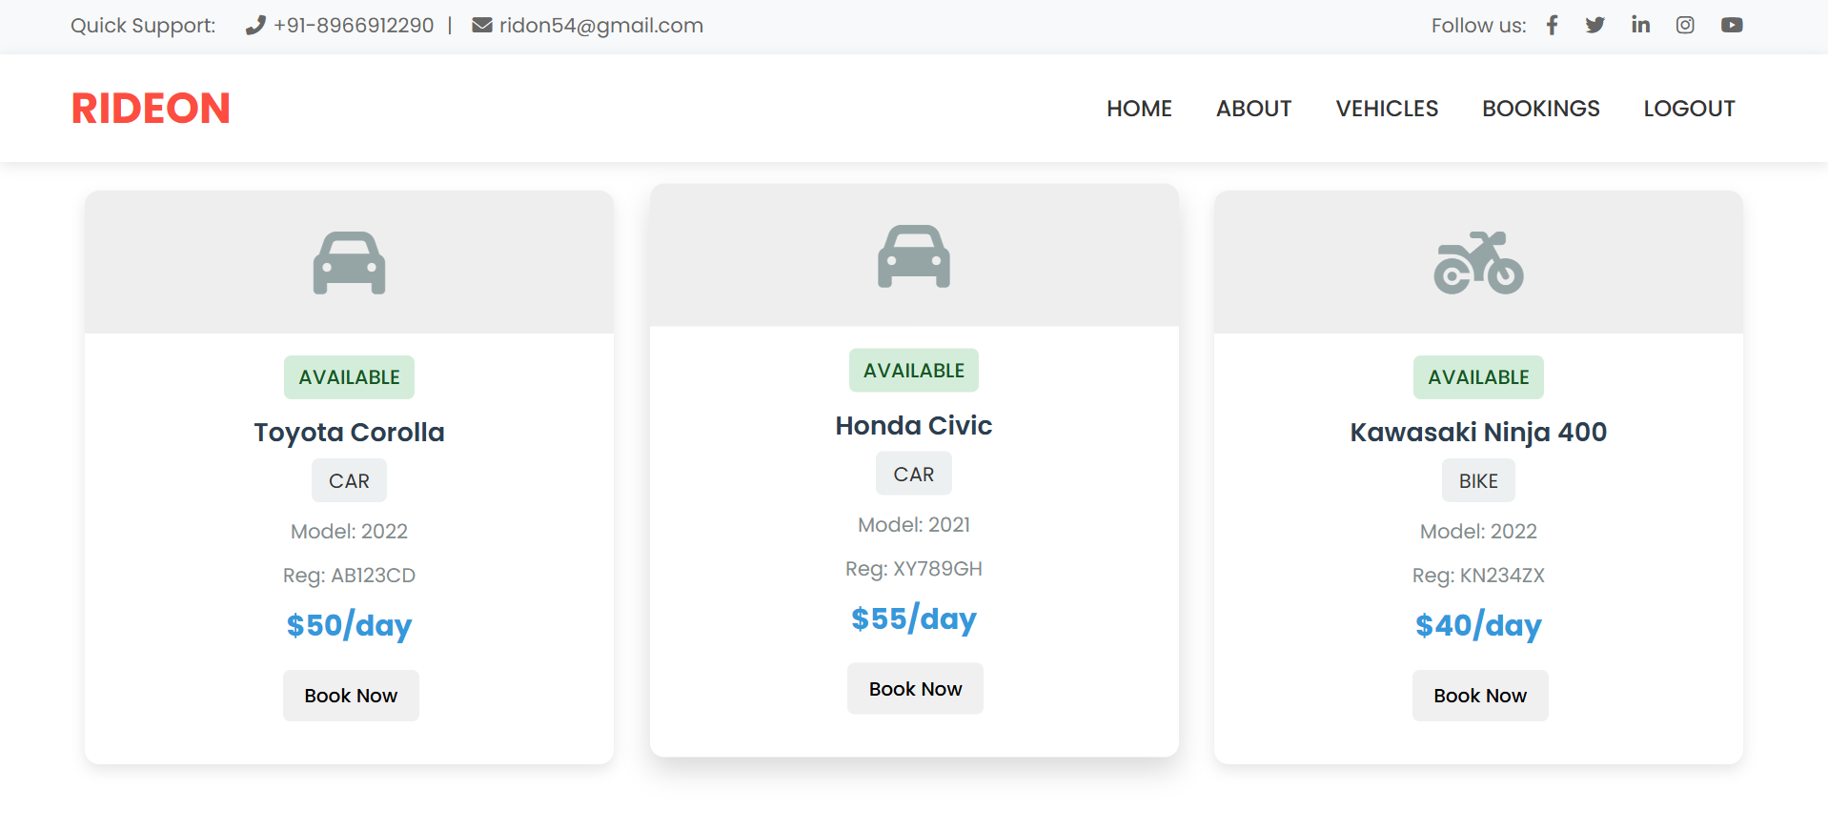
2. USER- VIEW AND BOOK VEHICLES

Slide 8
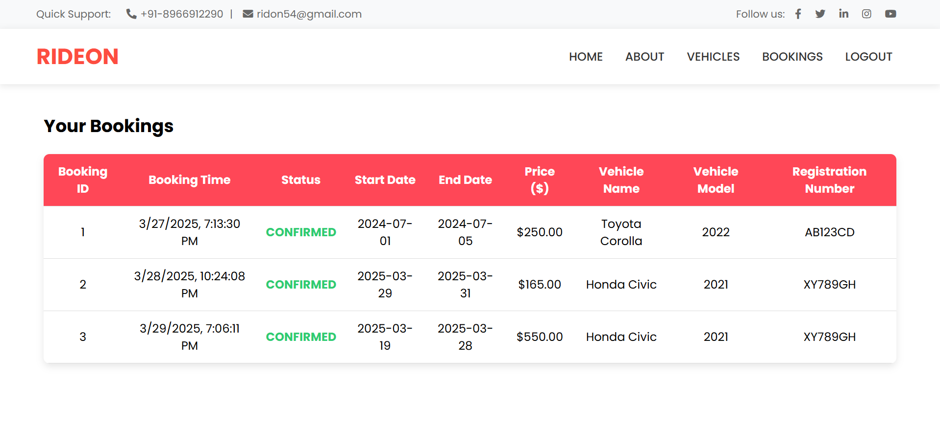
3. USER- VIEW BOOKINGS

Slide 9
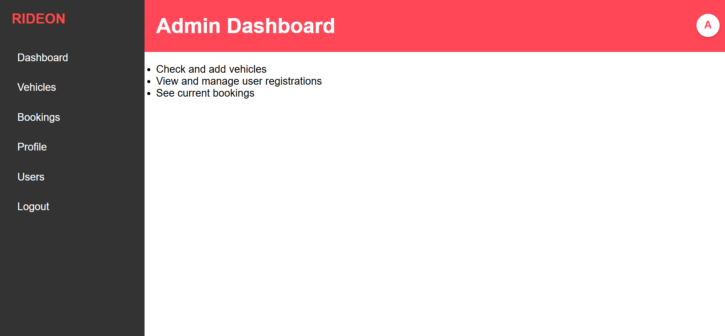
Admin dashboard

Slide 10
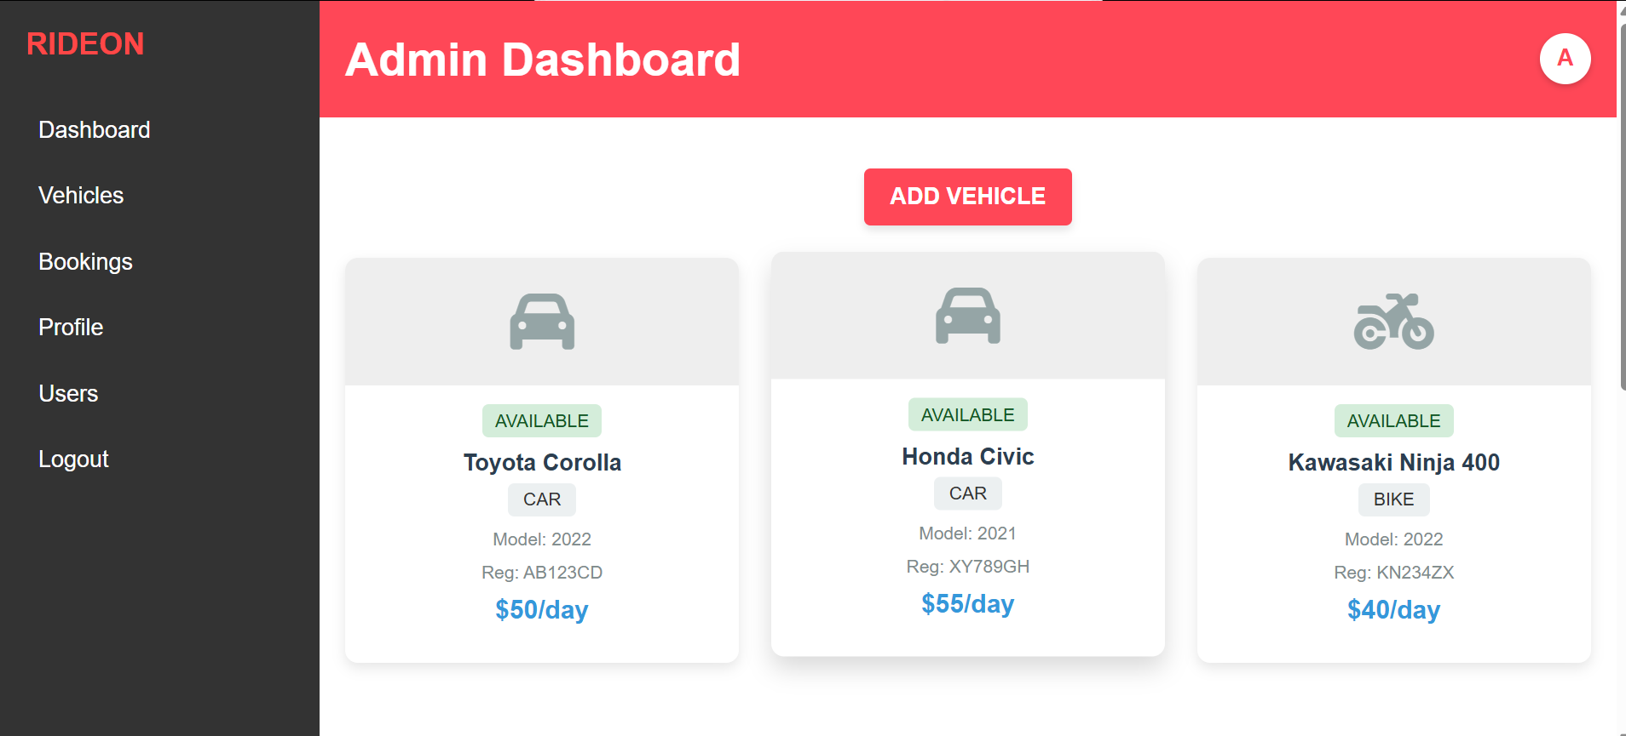
4. ADMIN- VIEW VEHICLES

Slide 11
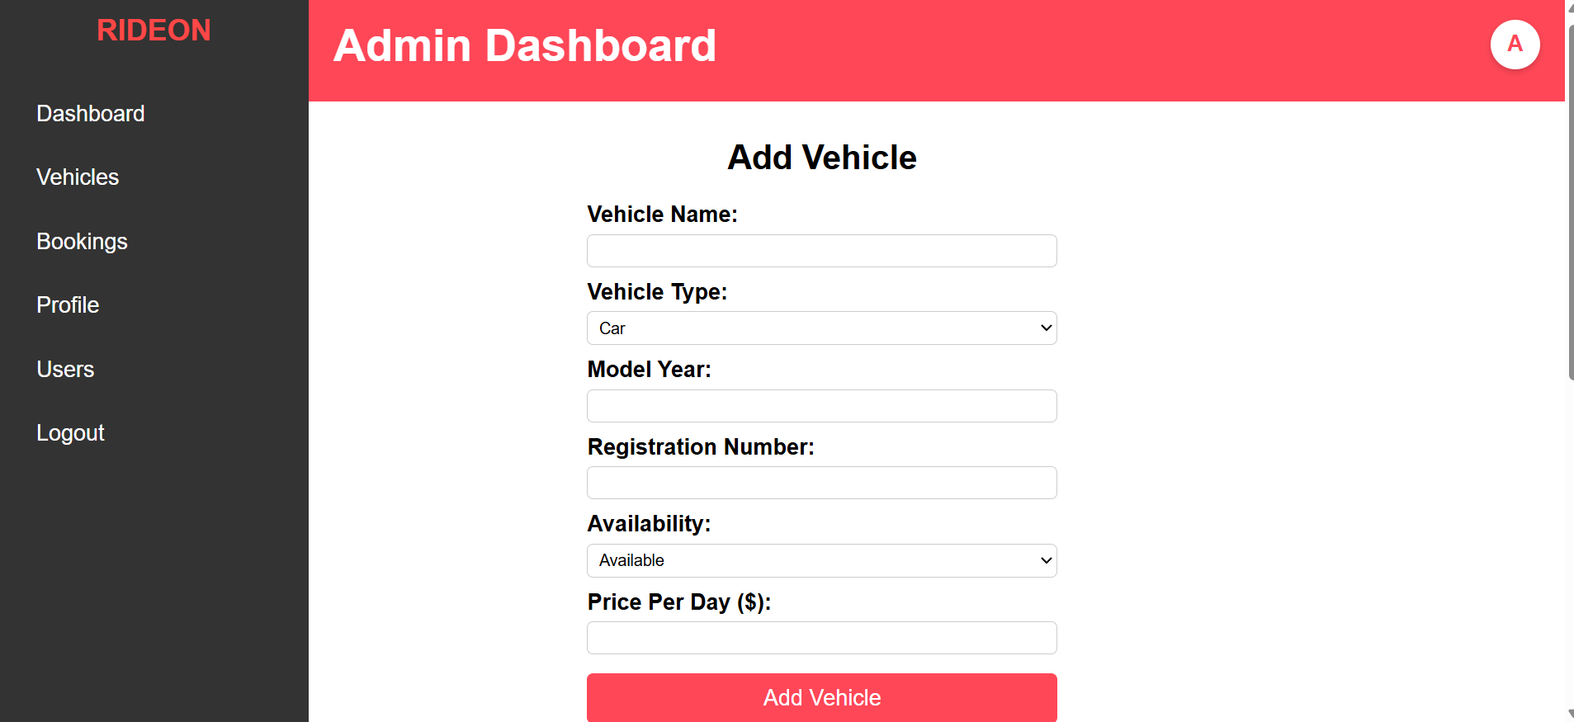
4. ADMIN- ADD VEHICLES

Slide 12
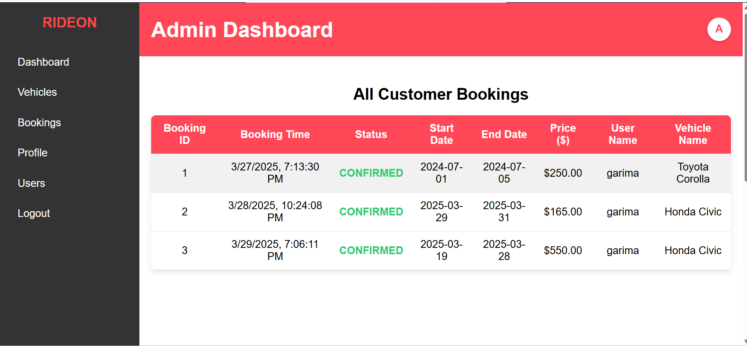
4. ADMIN- view bookings

Slide 13
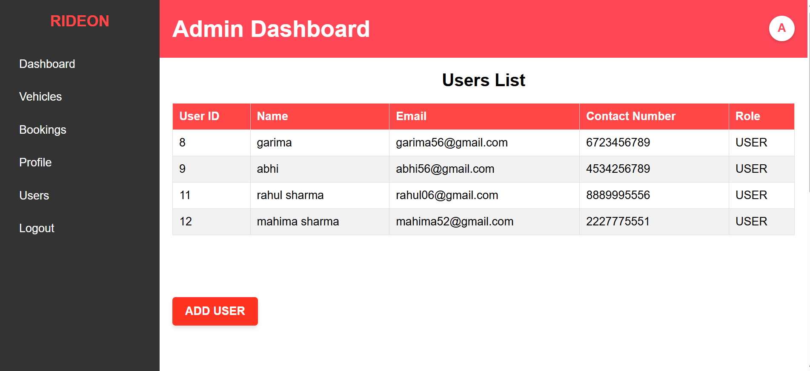
4. ADMIN- view users

Slide 14
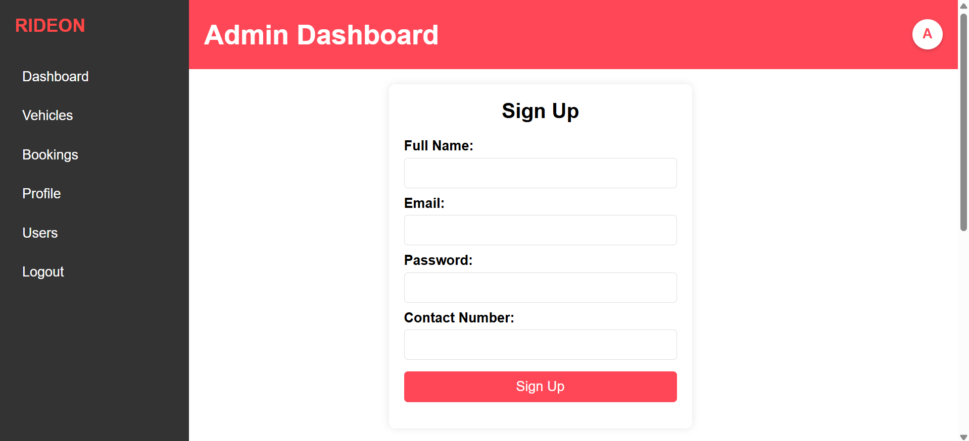
4. ADMIN- add users

Slide 15
Thank you

